Slide 1


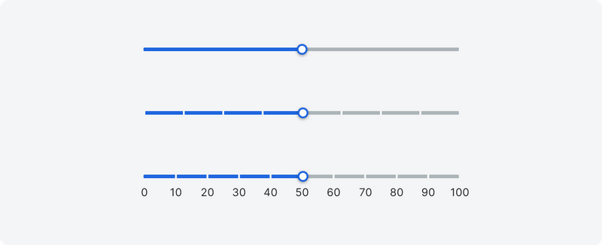





Slide 2
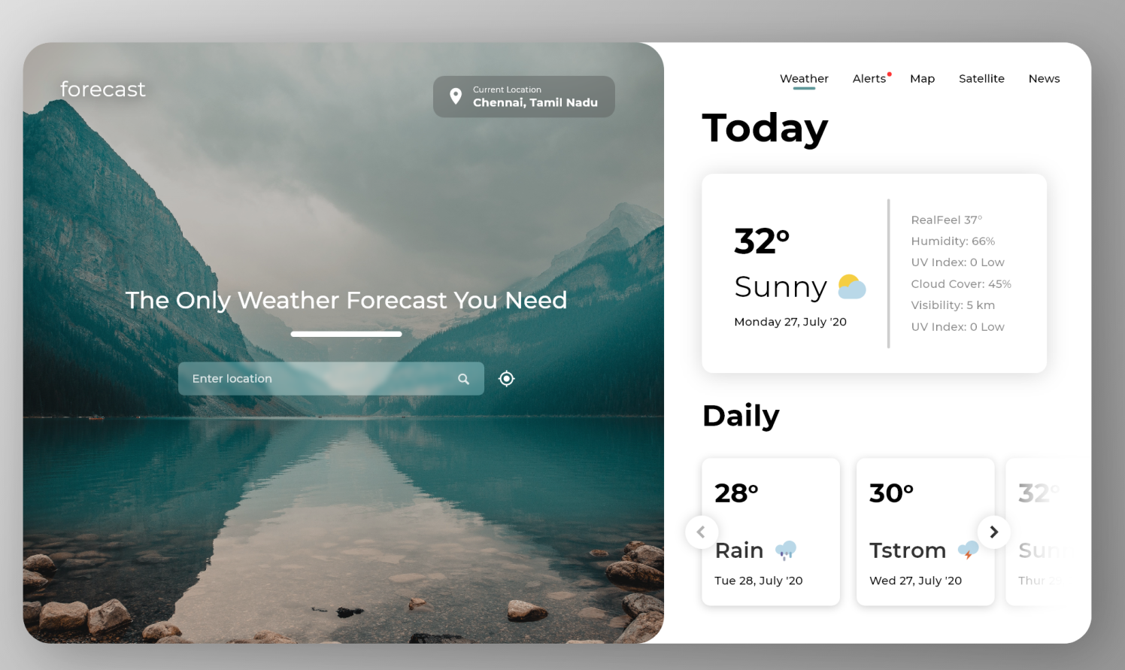
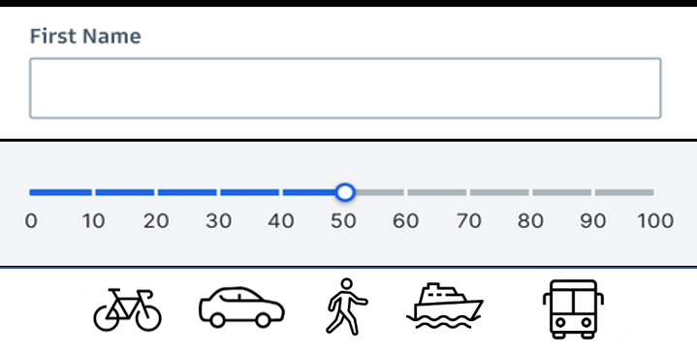
Find the sun

Slide 4










0mm
20°
3m/s
Oslo
2t30m
Oslo
13 OKT
2t30m
0mm
3m/s
20°
Trondheim
2t30m
0mm
3m/s
20°
Bergen
2t30m
0mm
3m/s
20°
Oslo
Oslo
2t30m
0mm
3m/s
20°
2t30m
0mm
3m/s
20°
06-12
12-18
18-00
00-06
Trondheim
12°
20°
15°
7°
20°
7m/s
0mm
12 OKT
2t30m
0mm
3m/s
20°
Bergen
Bergen
Trondheim
2t30m
0mm
3m/s
20°

Slide 5


2t30m
3m/s
Oslo
0mm
Bergen
16°
2t30m
17°
Trondheim
3m/s
Oslo
13 OKT
13 OKT
20°
0mm
06-12
12-18
18-00
00-06
06-12
12-18
18-00
00-06
06-12
12-18
18-00
00-06
12°
20°
15°
7°
12°
20°
15°
7°
12°
20°
15°
7°
20°
7m/s
0mm
12 OKT
20°
7m/s
0mm
12 OKT
20°
7m/s
0mm
12 OKT

Slide 6
Oslo
Bergen
16°
20°
17°
Trondheim
13 OKT
3m/s
13 OKT
13 OKT
0mm
2t30m
06-12
12-18
18-00
00-06
06-12
12-18
18-00
00-06
12°
20°
15°
7°
12°
20°
15°
7°
20°
7m/s
0mm
12 OKT
20°
7m/s
0mm
12 OKT
20°
7m/s
0mm
12 OKT

Slide 7
16/10
17/10

